Slide 1
Evaluating the risk of traffic crash in Chicago
Li Du
DATS6501 Data Science Capstone Project
Dec 4, 2018

Slide 2
Motivation & Objectives
Traffic crashes has been one of the major causes to transportation related deaths
In 2016, over 37,000 lives lost due to traffic accidents
Traffic crashes result in significant amount of economic costs*:
$1.5 million/fatal injury; $80,700/non-fatal disabling injury; $9300/property damage collisions
Can we predict the traffic crashes? ------- Most probably not, unfortunately…
How about to some extent, for example crash risk, so that the stakeholders can better allocate resources or take preventive measures?
* https://www.sawayalaw.com/blog/breaking-cost-accident/

Slide 3
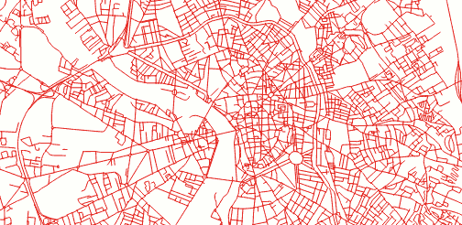



Datasets
Road network information (~20000)
Road length
Road width
No. of lanes
…
311 service requests (~120,000)
Crash reports (~90,000)
Street light out
Potholes
Tree trims
Tree debris
Time
Date
Weather
Driver info
Vehicle info
Fatality
…
Latitude, longitude

Slide 4
Methodology
How can we represent the risk of crash associated with each road segment?
Probability generated from a classifier may serve this purpose
Positive samples:
Latitude | Longitude | Road width | Street lights out | Hour of day | …
Negative samples:
Negative samples are of the same structure and format
Negative samples are “synthetic” by identifying the road segments without crash events and expand them across time (24h x 7days)
There are way more negative samples than positive samples, so the two classes needs to balanced. This can be done by randomly sampling the negative samples with sample size equal to the positive samples

Slide 5
Methodology (cont’d)
Modeling of traffic volume represented as annual averaged daily traffic (AADT)
Predictors: geographical reference, road network information
Outcome: predicted AADT values associated with road segment where such measurements are not available
Modeling of crash risk
Predictors: time, day, road network information, AADT
Outcome: predicted probability of crash using a classifier
Visualization

Slide 6
Modeling: AADT
Data quality check and preprocessing
Feature selection:
Drop features that did not pass the quality checks (e.g. to many missing records, text etc.)
Mutual information

Slide 7
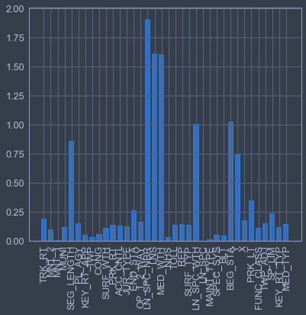
Mutual information
Number of special lanes
Total number of lanes
Median width
Width of special lanes
Road segment length
The mutual information between two random variables measures the dependency. The function as implemented by sklearn.feature_selection.mutual_info_regression relies on nonparametric methods based on entropy estimation from k-nearest neighbors distances*.
https://scikit-learn.org/stable/modules/generated/sklearn.feature_selection.mutual_info_regression.html

Slide 8
Modeling: AADT
Data quality check and preprocessing
Feature selection
Drop features that did not pass the quality checks (e.g. to many missing records, text etc.)
Mutual information
Test the performance of a few candidate models with different variable combinations (4 predictors retained in the final model)
Model selection and hyperparameter tuning
Nested cross validation

Slide 9
Modeling: AADT
Performances of four candidate models with 10 different seeds for the split of train and test data
 | KNN | Random forest | Gradient boosting | Ada boosting
R² | 0.985 ± 0.003 | 0.990 ± 0.002 | 0.981 ± 0.003 | 0.924 ± 0.013
Mean square log error | 0.132 ± 0.003 | 0.120 ± 0.004 | 0.242 ± 0.009 | 1.21 ± 0.094

Slide 10
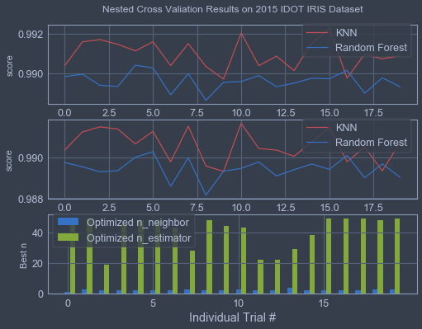
Modeling: AADT

Slide 11
Modeling: AADT
Data quality check and preprocessing
Feature selection
Drop features that did not pass the quality checks (e.g. to many missing records, text etc.)
Mutual information
Test the performance of a few candidate models with different variable combinations (4 predictors retained in the final model)
Model selection and hyperparameter tuning
Nested cross validation
KNN with n = 2

Slide 12
Modeling: crash
Random forest model was selected due to its interpretability
Feature selection was done based on the ones selected from the AADT model and evaluating the new variables such as 311 report data and crash day/time
Training set was created by combining positive samples and negative sample and balancing the two classes
The performance was evaluated by the classification accuracy (95%)

Slide 13
Final results and visualization
The final results are visualized by Tableau
Interesting insights
Dashboard application

Slide 14
Caveats and future work
Random forest has been reported to generate probabilities that are biased. Other methods such logistic regression with lasso may be potentially helpful.
Think about other metrics or modification of current metric to better represent the idea of crash risks
Weather condition reported by the crash reports may result in bias estimation, and should be reconsidered and maybe removed

